Slide 1
Tax Preparation
Course Introduction
Pub 4491 – Part 1 – Lesson 1

Slide 2

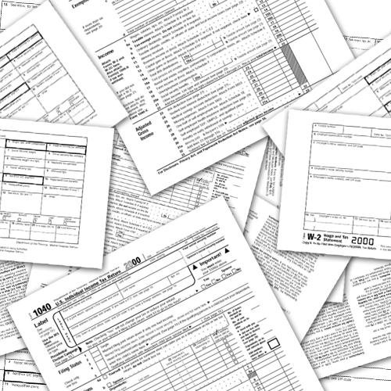
Welcome
AARP Tax-Aide education is all about:
  Interaction with taxpayer
  Forms
  Data
  Calculations
Notes:
All gets organized into a process which will be discussed shortly.

Slide 3
AARP Foundation Tax-Aide
Nationwide non-profit program administered by AARP Foundation
Helps low-to-moderate income taxpayers with special attention to age 60+
Free confidential service
Committed to high-quality service
Answers tax questions/prepares returns
Funding from AARP Foundation and IRS
Notes:
There are no age or income restrictions

Slide 4
Objectives
Course levels and training approach
Certification process
Volunteer responsibilities
Critical components of return preparation process
Resources available

Slide 5
Course Levels
Two Levels
  Basic – for Volunteer Income Tax Assistance (VITA) sites (not Tax-Aide)
  Advanced – all Tax-Aide Counselors
Optional Courses
  Health Savings Accounts
  Military
  International
Notes:
New Volunteers, generally, do not certify in optional courses during first year. All Counselors must also successfully pass the Standards of Conduct test and the new Intake/ Interview and Quality Review test.

Slide 6
Training Approach
TaxSlayer Immersion
  Learn the application of law while immersed in the tax software;
  Learn to use IRS reference manuals & AARP resource material
  Follow Process Based Training (PBT):
    Structured process combining interview, application of law, and tax software to complete return followed by full Quality Review of the return
Notes:
Reference Manuals to be shown in later slides.

Slide 7
Training Approach
Income tax training
  Start with basics
  Continue through complete return
  It becomes a process
  Course follows progression through Form 1040

Slide 8
Tax Return Preparation is a Process
Greet taxpayer and verify identity with photo ID and SSN
Complete Federal return
Complete e-file
Quality Review by second Counselor with taxpayer
Review I&I form and discuss all answers with taxpayer
Complete Health Care section
Print return(s) for taxpayer
Complete State/Local returns if applicable
Start return, enter Basic Information
Taxpayer signature(s)
Select applicable forms using Quick File
Review Summary – correct any errors
Collate copies – review w/taxpayer
Notes:
From Pub 4012

Slide 9
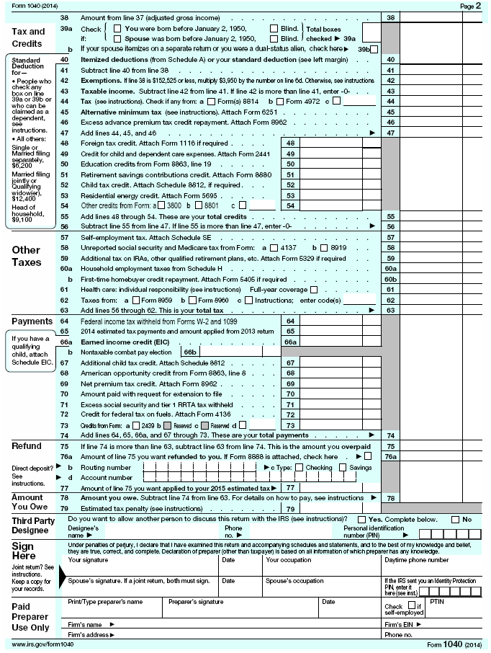
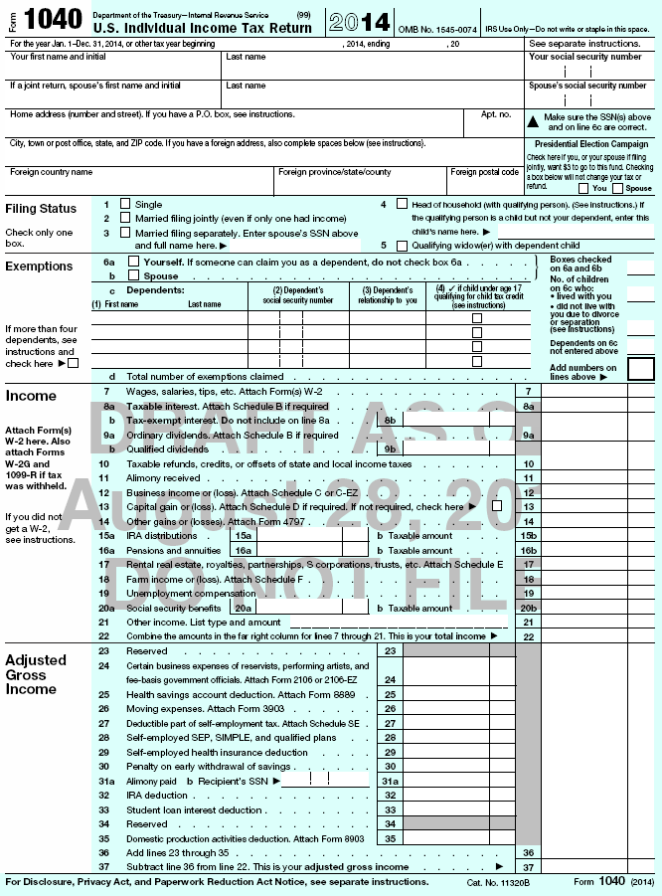
Federal Return (1040)
2016
Deductions
General Info
Tax
Non-refundable Credits, Payments &
Refundable Credits
Income
Account info
Adjustments
Signatures
Notes:
Briefly describe type of content in each section and that training will work through the 1040 line-by-line in order.

Slide 10
Filing Returns
All returns completed on computer
  TaxSlayer® software supplied by IRS
    On-line version (TaxSlayer Pro) resides on vendor’s server
All returns must have Quality Review
  2nd pair of eyes
All returns filed electronically
Each taxpayer receives printed copy

Slide 11
Certification Process
Complete three tests to meet IRS/AARP Tax-Aide certification requirements
  Volunteer Standards of Conduct (VSC) Test
  IRS Intake/Interview & Quality Review Test
  Advanced Test
Minimum score of 80% required on each
May take one retest if necessary
Show competency in use of TaxSlayer
New volunteers generally do not complete optional courses

Slide 12
Volunteer Responsibilities
Stay within scope of program
Stay within training completed
Become familiar with and use resources
  IRS Pubs: especially, Pub. 4012
  AARP resource material & IRS help facilities
  State Pubs and help facilities
  Fellow counselors
  AARP Tax-Aide Cybertax Alerts
Understand return is client’s responsibility

Slide 13
Volunteer Responsibilities
Protect confidentiality and security
Do not retain any data at site
Record ALL activity at site every shift
Follow site’s e-file process

Slide 14
Volunteer Responsibilities
Protect confidentiality and security
Do not retain any data at site
Record ALL activity at site every shift
Follow site’s e-file process

Slide 15
Volunteer Protection Act of 1997
Certified volunteers not liable if:
  Received IRS/AARP Foundation Tax-Aide Training
  Harm not wilful
  Act within scope of program and training
  AARP Foundation Tax-Aide policies and procedures are followed

Slide 16
Expectations for Instructors
Provide positive learning experience
Help you learn and understand preparation process
Answer questions
Check workbook assignments
Provide feedback

Slide 17
Expectations for Volunteers
Be positive (not disruptive) in a learning environment
Follow directions (don’t jump ahead)
Ask questions
Timely completion of assignments
Successful certification

Slide 18
Process Components
Each will be covered in detail
IRS Forms
  Form 13614-C
  Form 1040
  W-2
  Form 1099 (various)
  ACA forms: 8962, 8965, 1095-A, etc.
  And more!
IRS Publications
  Pub 4012
  Pub 4491
  Pub 17
TaxSlayer Software
State reference material & forms as applicable

Slide 19





Training Reference Icons
Definitions
Interview
Tax Law
TaxSlayer
Quality
Review
Exit
Interview
Practice

Slide 20
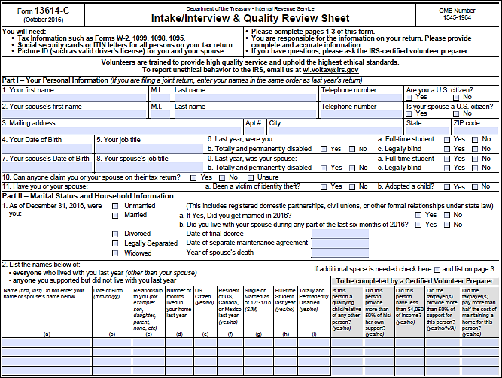
The Starting Point – Taxpayer Interview

Slide 21
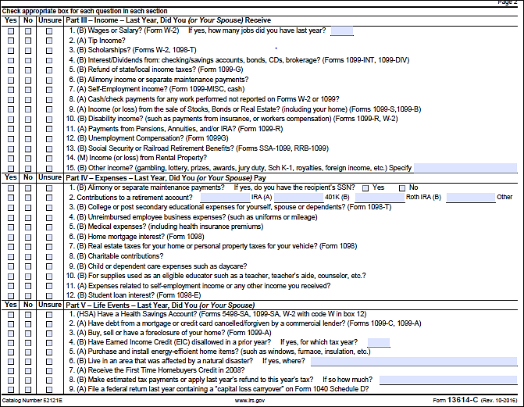
Form 13614-C: Intake/Interview Sheet

Slide 22
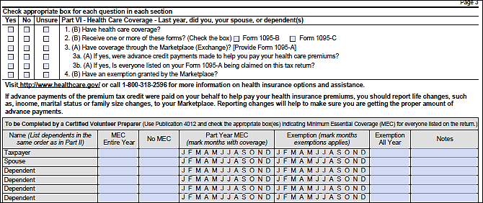
Form 13614-C Part IV: Health Care Coverage

Slide 23
Course Introduction
Questions?
Comments…

